Slide 1



November 20, 2023
Program Introduction
Welcome to Data Science!
Notes:
Adapted with <3 by Lindsey Berlin

Slide 2

Agenda
Your campus DS Team
Course Structure
Day-to-day expectations
Program tools
Assessment details
Setting yourself up for success

Slide 3


Your DS Squad
Me!
Notes:
The squad officially attached to this cohort - but not the only Data Science staff you’ll interact with!

Slide 4
Course Structure
Pipelines, Unsupervised Learning + Special Topics
NLP
Neural Networks
Statistical Inference
and
Linear Regression
Phase 1
Phase 2
Phase 4
Phase 5
Phase 3
Data Acquisition, Manipulation
And
Visualization
Supervised Machine Learning:
General Principles
and
Regression/Classification
Capstone Project

Slide 5

Day-to-Day Expectations: The Anatomy of a Phase

Slide 6

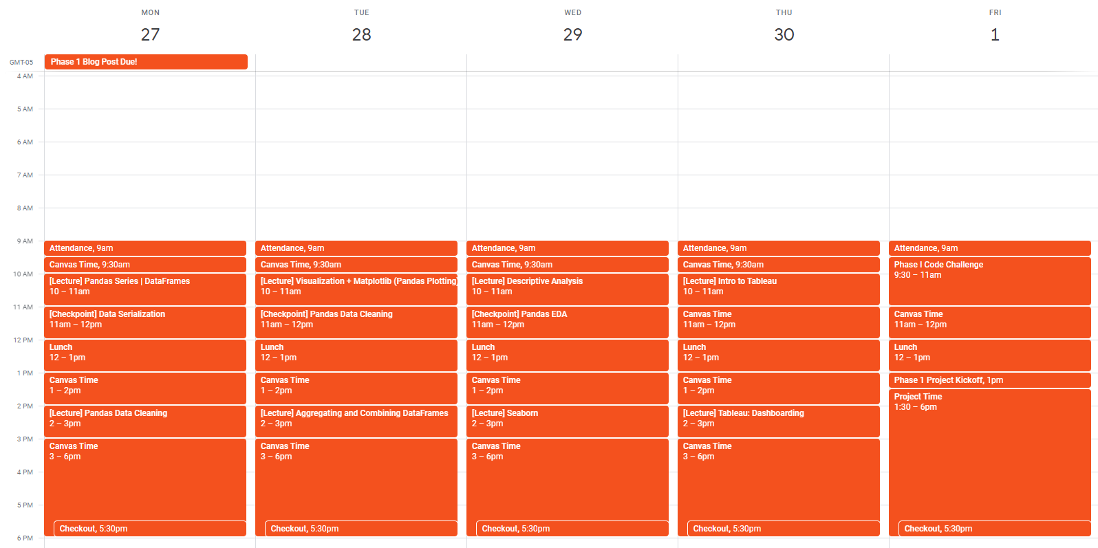
Weeks 1 & 2
The Normal Weeks

Slide 7
Weeks 1 & 2
Attendance

Slide 8
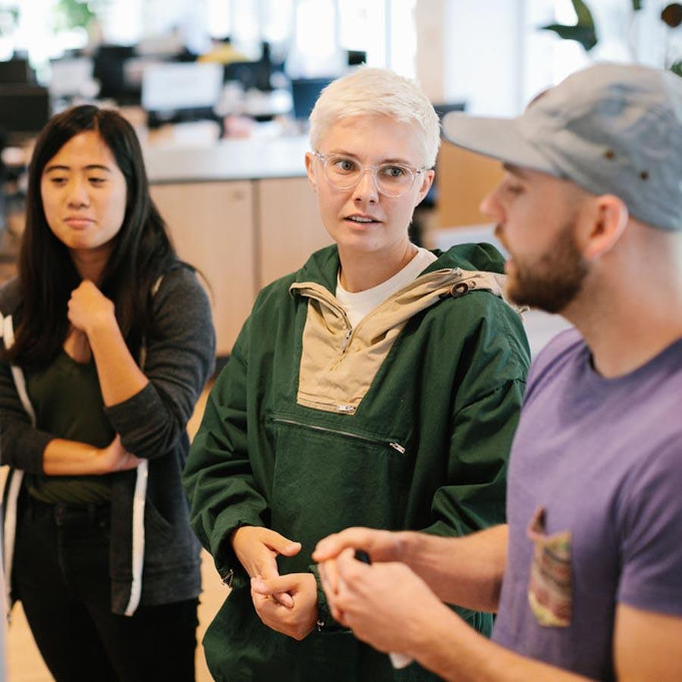
Attendance
We will check in and check out every day.
We take attendance! (refer to attendance policy)
- 7 absences
- 3 lates = 1 absence
Attendance mandatory for compliance
Will include:
Communicating events and deadlines

Slide 9
Weeks 1 & 2
Checkout

Slide 10
Checkout
We will check in and check out every day.
We take attendance! (refer to attendance policy)
- Mark you if you are still here at end of day.

Slide 11
Weeks 1 & 2
Lectures

Slide 12
Lectures
Plan to:
Ask questions. Participate.
Take notes.
Code along when appropriate.

Slide 13

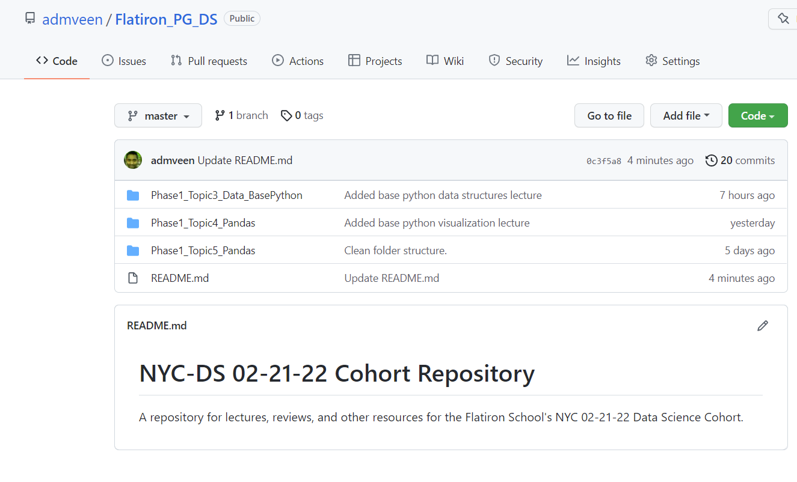
Cohort Git Repository
AKA where to find lecture content!
We will go over how to access materials from this repository in Week 1.

Slide 14
Weeks 1 & 2
Canvas Time

Slide 15

Canvas Time
Also known as Personal Working Time.
- Canvas is where the curriculum/individual lessons are located
- Quizzes on Canvas: checks for understanding. NOT official assessments, but reference for yourself.
Please feel free to work together and collaborate on labs and quizzes.
Notes:
You WILL NOT go through every single lesson and lab in this curriculum in 15 weeks. You should not try. Focus on the first priority lessons/labs, use second and third priority to help practice, and remember that you can download the entire curriculum at the end of the course so you have these references later if you want to look back.
Quizzes are quick checks for understanding - you can take them repeatedly, and they’re often designed to be repetitive - please take them!

Slide 16
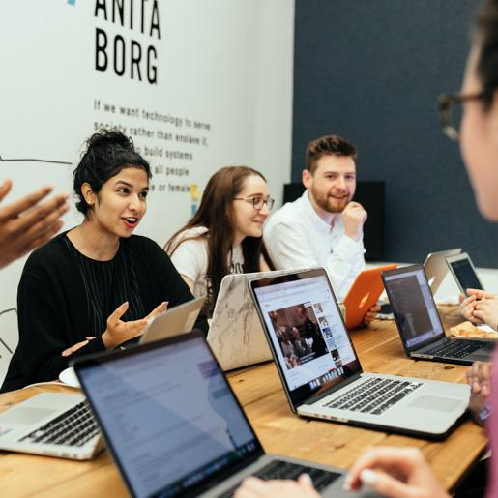

Program Tools
Notes:
Want to spend just a few minutes giving a high level overview of the tools we use every day

Slide 17


Canvas
Homeroom
Phase
Programmatic Content:
Cohort Calendar
Program resources and information
Surveys
Textbook and Workbook:
Lessons
Labs
Quizzes (not graded!)
Plus: Ask Ada & Pair with a TC
Notes:
Canvas is our learning management system, which is where all of the curriculum content sits. We’ll talk through what working canvas will really look like, in terms of what to focus on, both later in this presentation and throughout the course - for now, let’s just introduce the platform.
You should have access to Homeroom, which has your cohort calendar, program resources and information, and eventually the surveys we’ll ask you to take at the end of each phase
You should see Phase 1 in your Canvas accounts. The rest of the phases will get published as we get closer to those dates!
Quizzes on Canvas do not count as official assessments - they are for your benefit, to check your understanding and progress. You can ask us to review them with you, but otherwise we likely won’t be checking in on those scores.
You should check Canvas throughout the day - bookmark your courses for easy access!

Slide 18
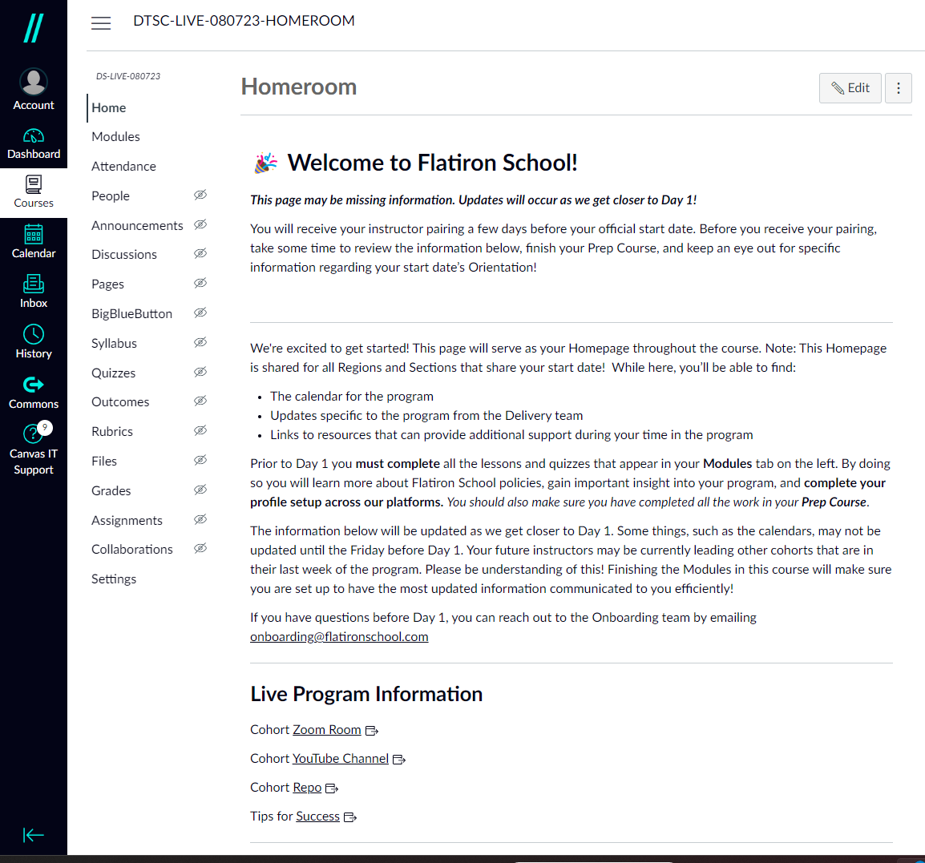
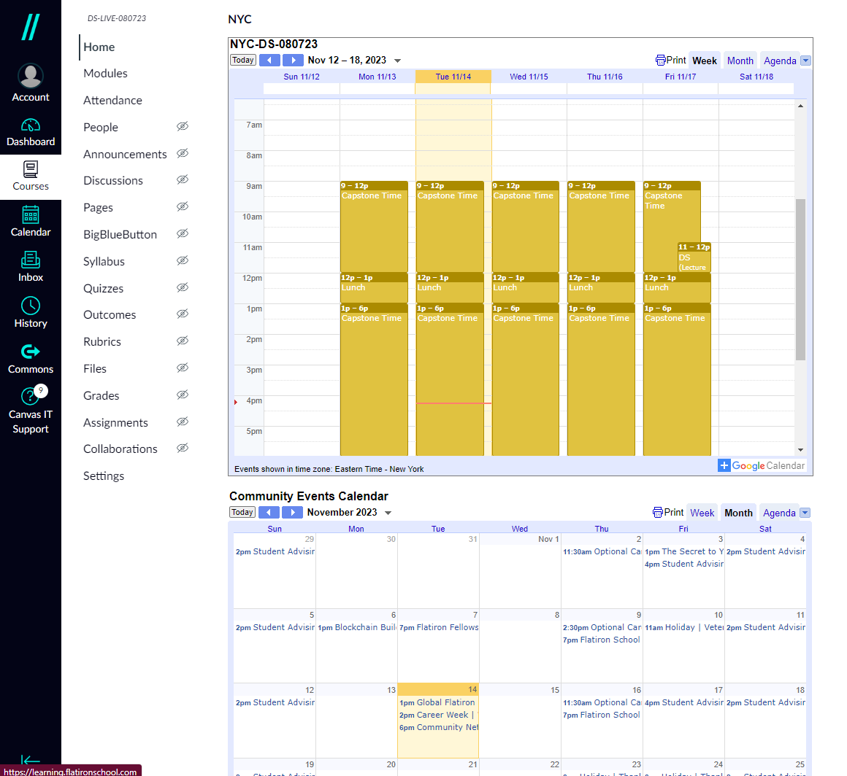
Homeroom
General Resources + Calendar
Notes:
Two ways to access illumidesk from within canvas: either through the direct link on the left side bar or through assignment links (which will take you to a page where you can open illumidesk in a new window). You will most frequently use it through assignments

Slide 19
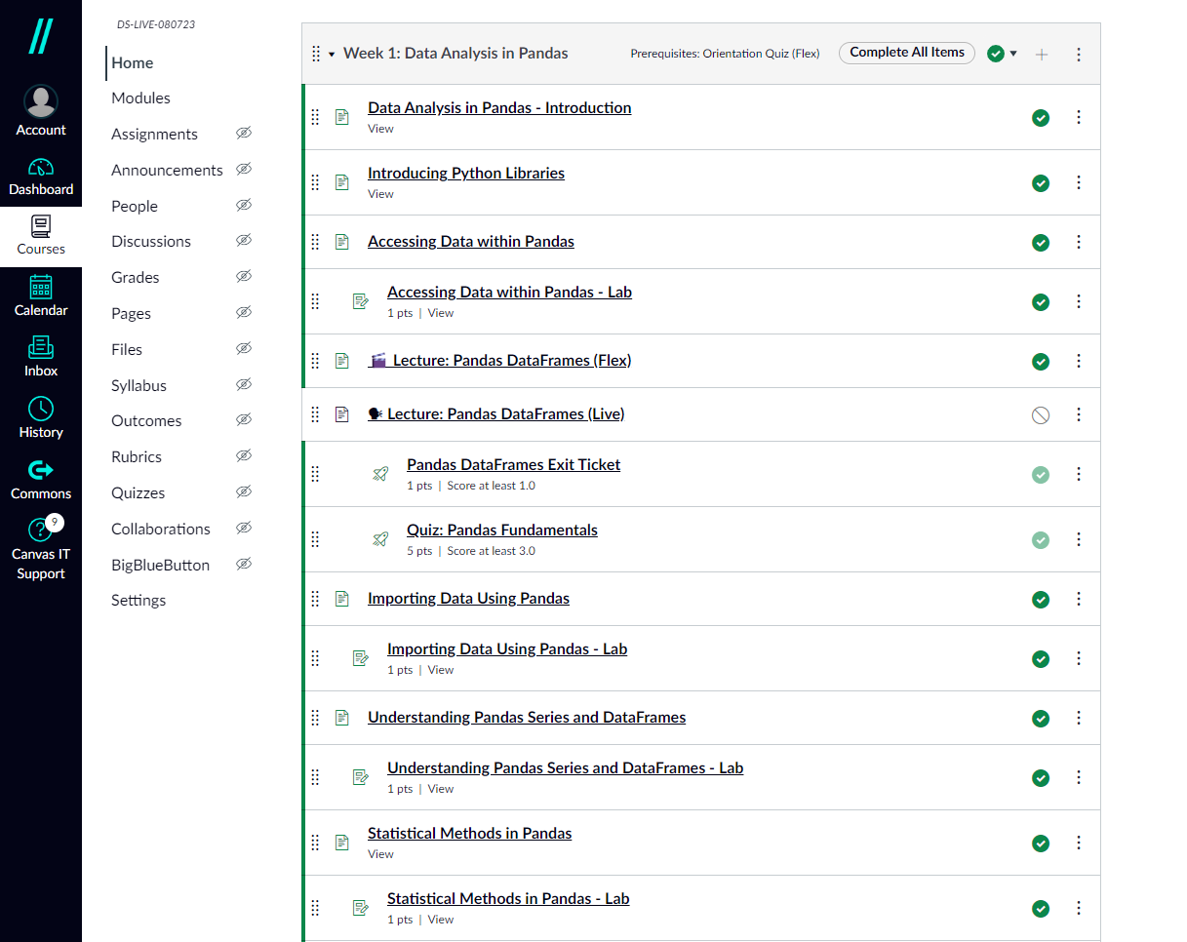
Phase Course
Lessons
Content Organization
Labs
Quizzes
(not required)
Notes:
Two ways to access illumidesk from within canvas: either through the direct link on the left side bar or through assignment links (which will take you to a page where you can open illumidesk in a new window). You will most frequently use it through assignments

Slide 20
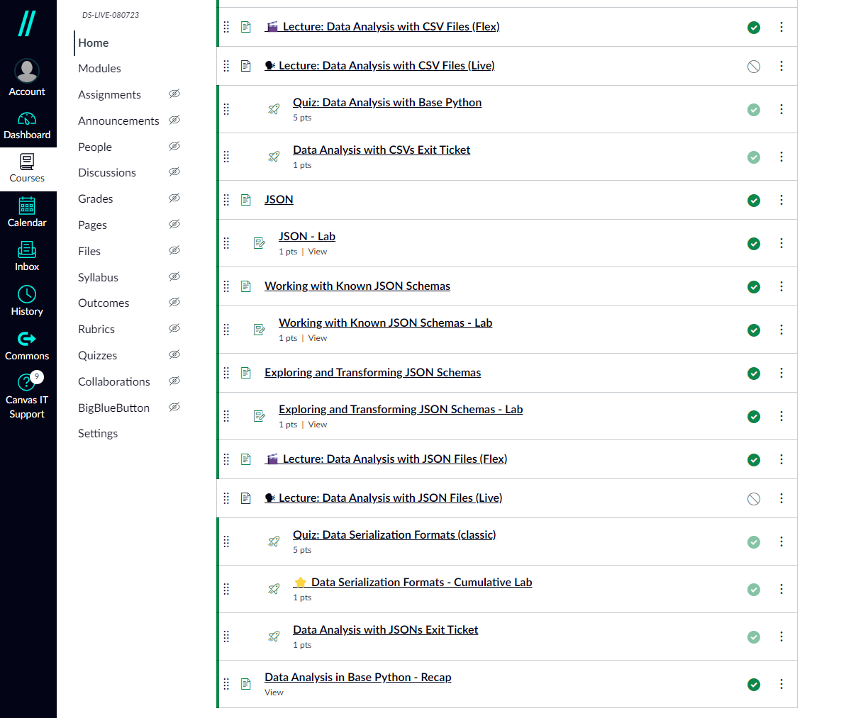
Phase Course
Cumulative Labs (very important)
Content Organization
Exit Tickets
(not required)
Notes:
Two ways to access illumidesk from within canvas: either through the direct link on the left side bar or through assignment links (which will take you to a page where you can open illumidesk in a new window). You will most frequently use it through assignments

Slide 21
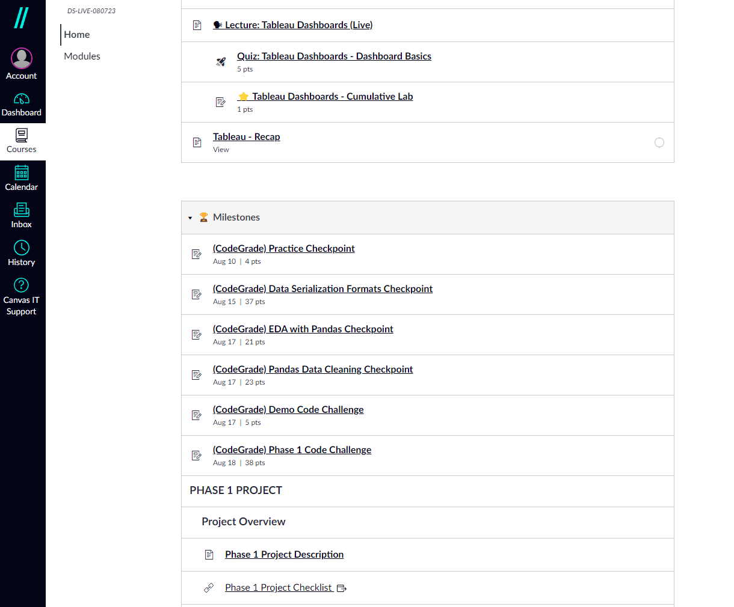
Phase Course
Main Evaluations
Content Organization
Notes:
Two ways to access illumidesk from within canvas: either through the direct link on the left side bar or through assignment links (which will take you to a page where you can open illumidesk in a new window). You will most frequently use it through assignments

Slide 22
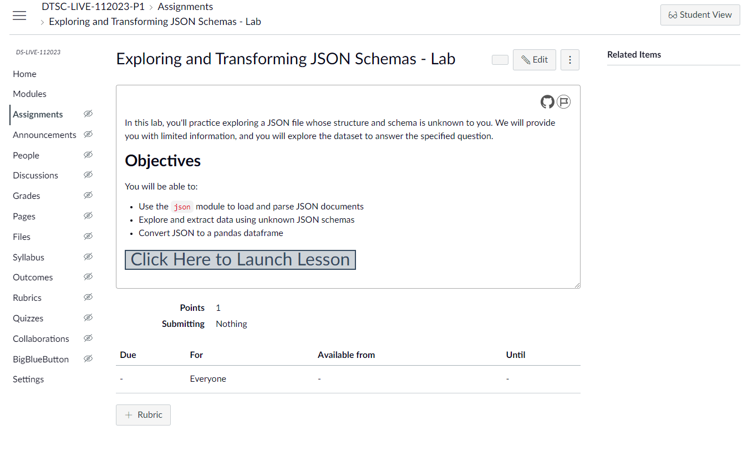


Advantages of Working Locally
Accessing Labs
Advantages of Working on IllumiDesk
Each lab has a launcher from Canvas to Saturn Cloud
Ease of use
No environment issues
Fully integrated into Canvas
Notes:
Note that you will need to access lecture content and work on projects locally - so don’t sweat using illumidesk if it’s easier for code lessons and labs. Plus, you will have time after graduation to download all course materials - so, even if it’s more organized and easier to capture your own work on labs locally, you’ll never lose access to the materials.

Slide 23
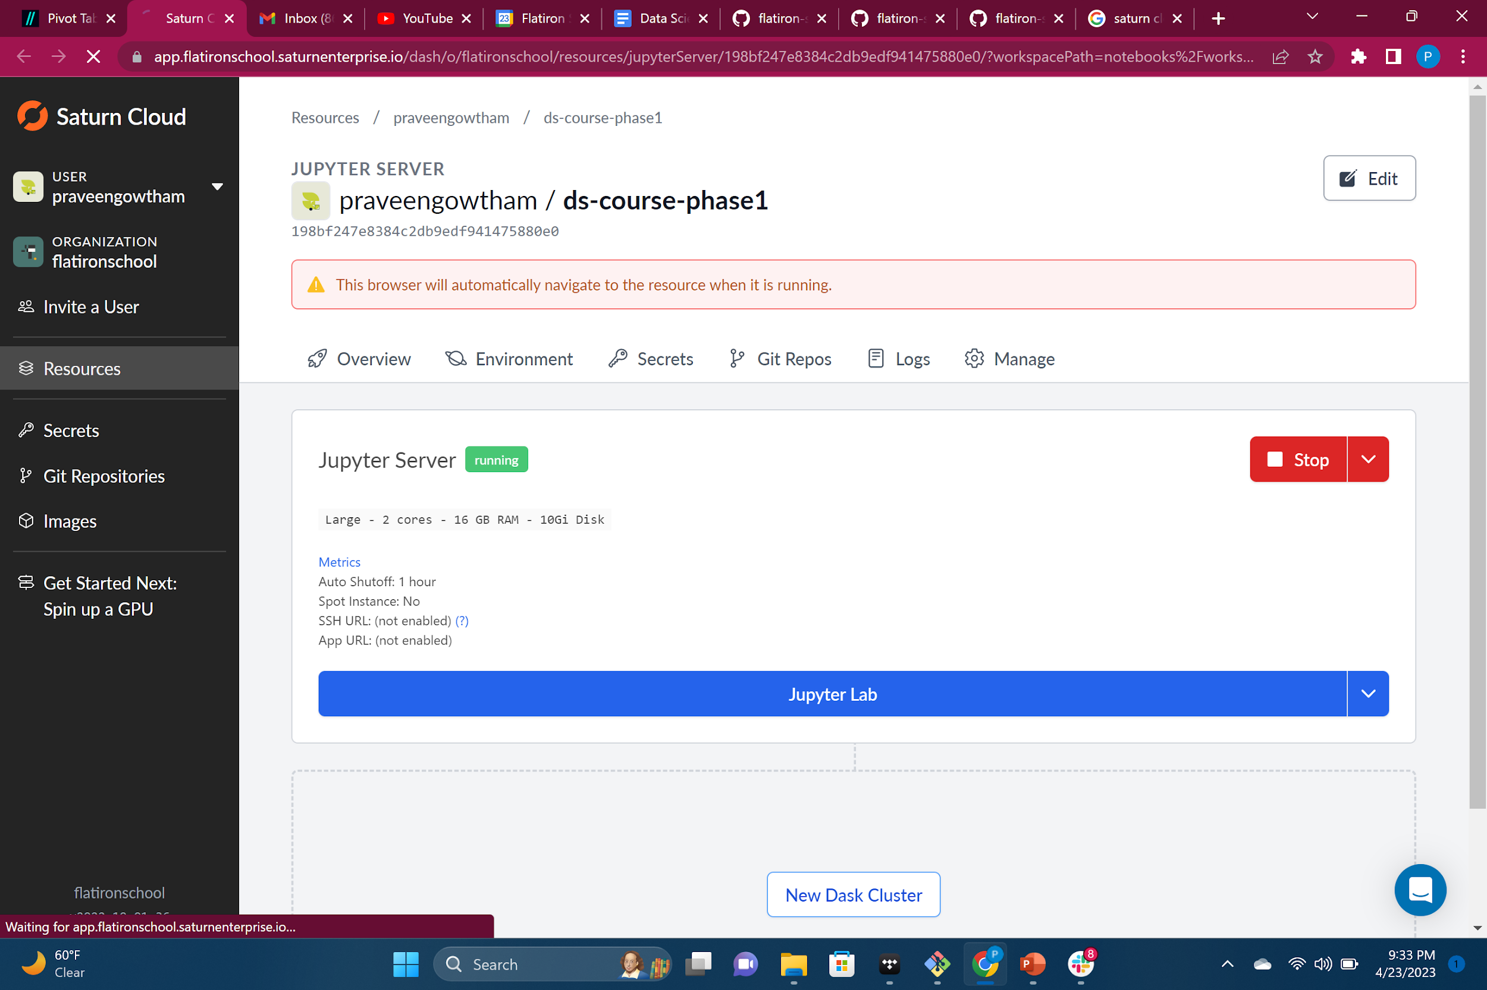

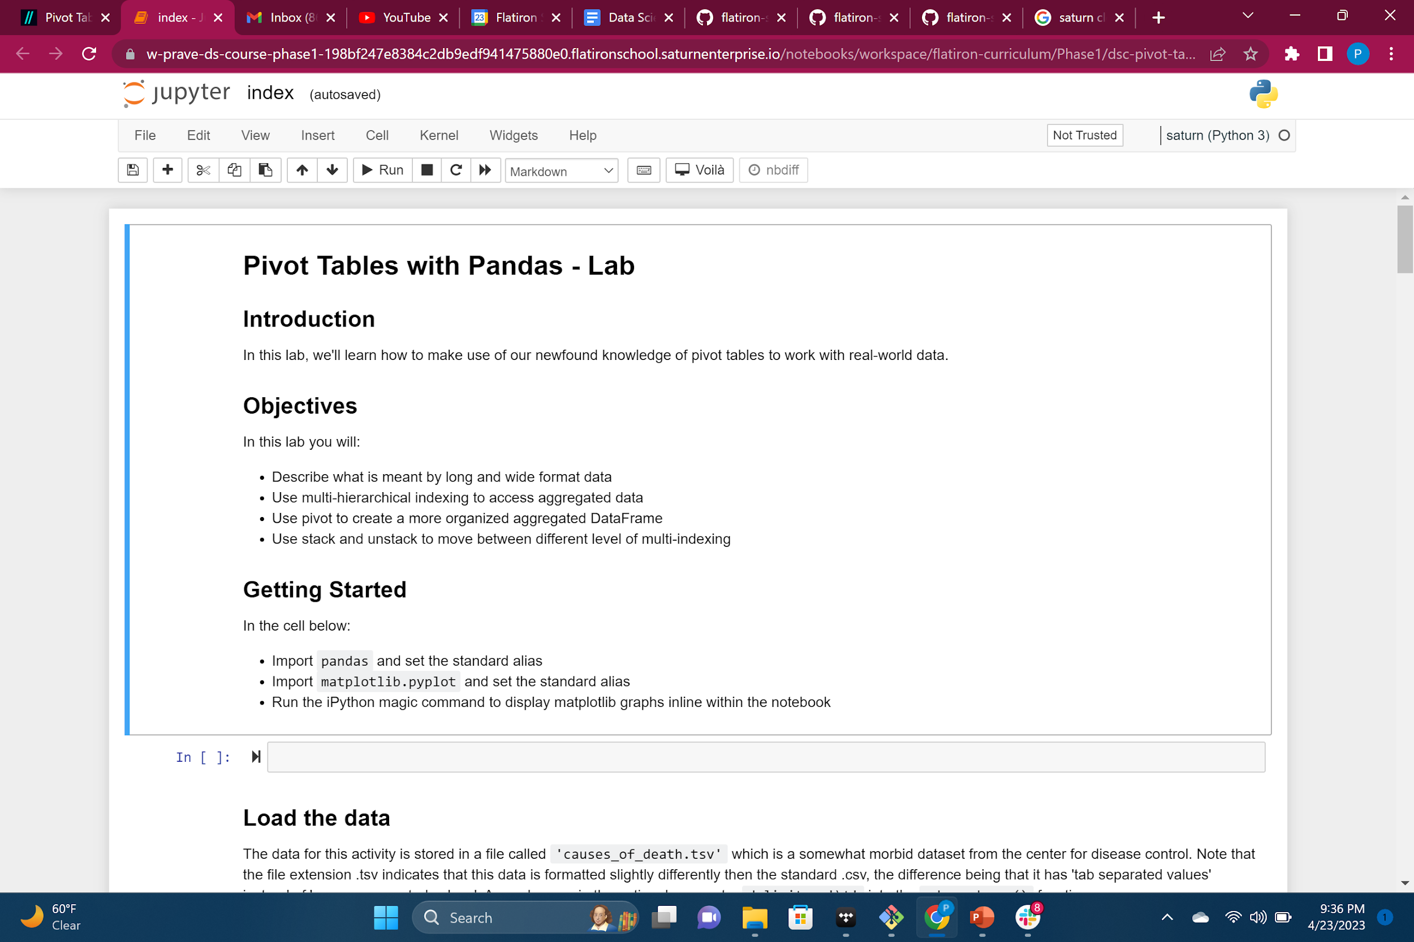
Advantages of Working Locally
Saturn Cloud
Advantages of Working on Saturn Cloud
Practice using Git / GitHub → in-demand skills!
Forking labs on GitHub contributes to a robust, ‘green’ commit history
Content is more accessible after the program
More ‘real world’
Launching Labs in Canvas:
Spins up Saturn Cloud server
Loads lab in Jupyter Notebook instance
Work on lab and save progress in the cloud.
Notes:
Note that you will need to access lecture content and work on projects locally - so don’t sweat using illumidesk if it’s easier for code lessons and labs. Plus, you will have time after graduation to download all course materials - so, even if it’s more organized and easier to capture your own work on labs locally, you’ll never lose access to the materials.

Slide 24
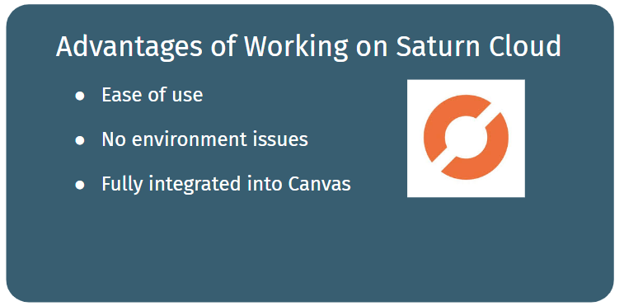
Advantages of Working Locally
Accessing Labs
Advantages of Working on IllumiDesk
Practice using Git / GitHub → in-demand skills!
Forking labs on GitHub contributes to a robust, ‘green’ commit history
Content is more accessible after the program
More ‘real world’
Every lesson and lab is stored on GitHub - it’s also where you can find lab solutions!
We’ll teach you how to easily download GitHub repositories soon - so, should you do labs locally or in Saturn Cloud?
Short answer: both! Each method has their pros and cons.
Ease of use
No environment issues
Fully integrated into Canvas
Notes:
Note that you will need to access lecture content and work on projects locally - so don’t sweat using illumidesk if it’s easier for code lessons and labs. Plus, you will have time after graduation to download all course materials - so, even if it’s more organized and easier to capture your own work on labs locally, you’ll never lose access to the materials.

Slide 25
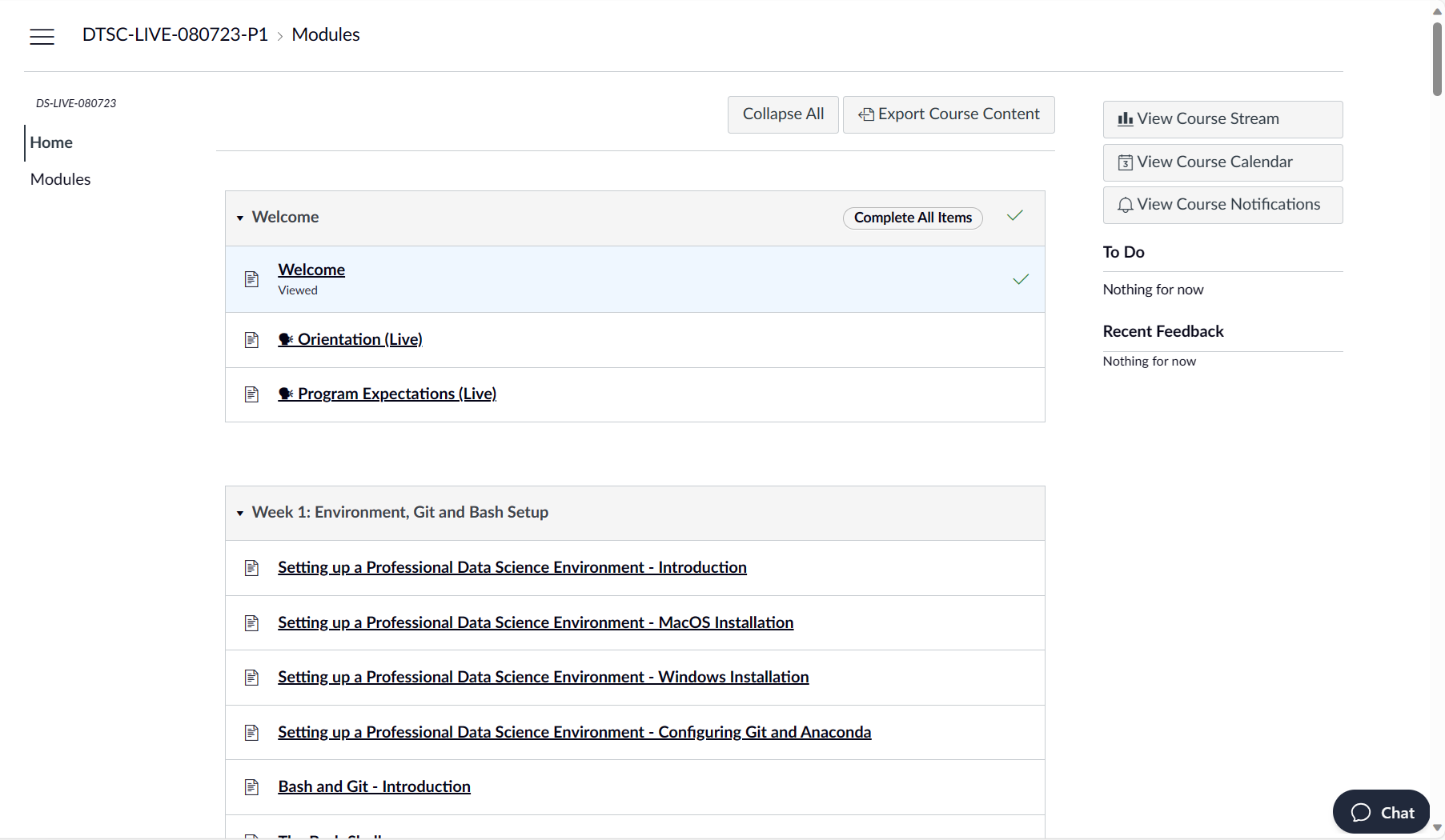
Ask ADA + Pair with TC
Notes:
One important note! To see your cohort calendar, you must navigate to Homeroom
The Calendar icon in the left-hand navigation bar doesn’t take you to your cohort calendar
For easy access to your cohort calendar (if you are a gmail user), click “add calendar” in the bottom right corner of the embedded calendar and you can add it to your own gmail!

Slide 26
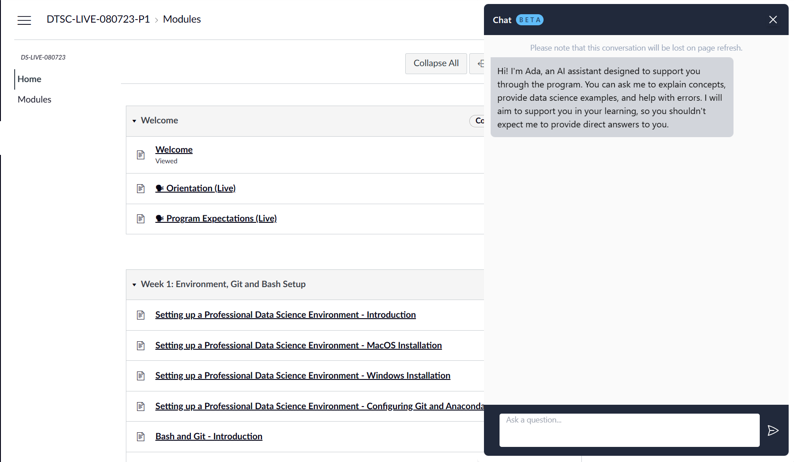
Ask ADA + Pair with TC
Notes:
One important note! To see your cohort calendar, you must navigate to Homeroom
The Calendar icon in the left-hand navigation bar doesn’t take you to your cohort calendar
For easy access to your cohort calendar (if you are a gmail user), click “add calendar” in the bottom right corner of the embedded calendar and you can add it to your own gmail!

Slide 27


Assessment Details
Notes:
There are four ways we evaluate your readiness as you progress through the program: blog posts, checkpoints, code challenges, and projects.

Slide 28
Weeks 1 & 2
Blog Posts

Slide 29
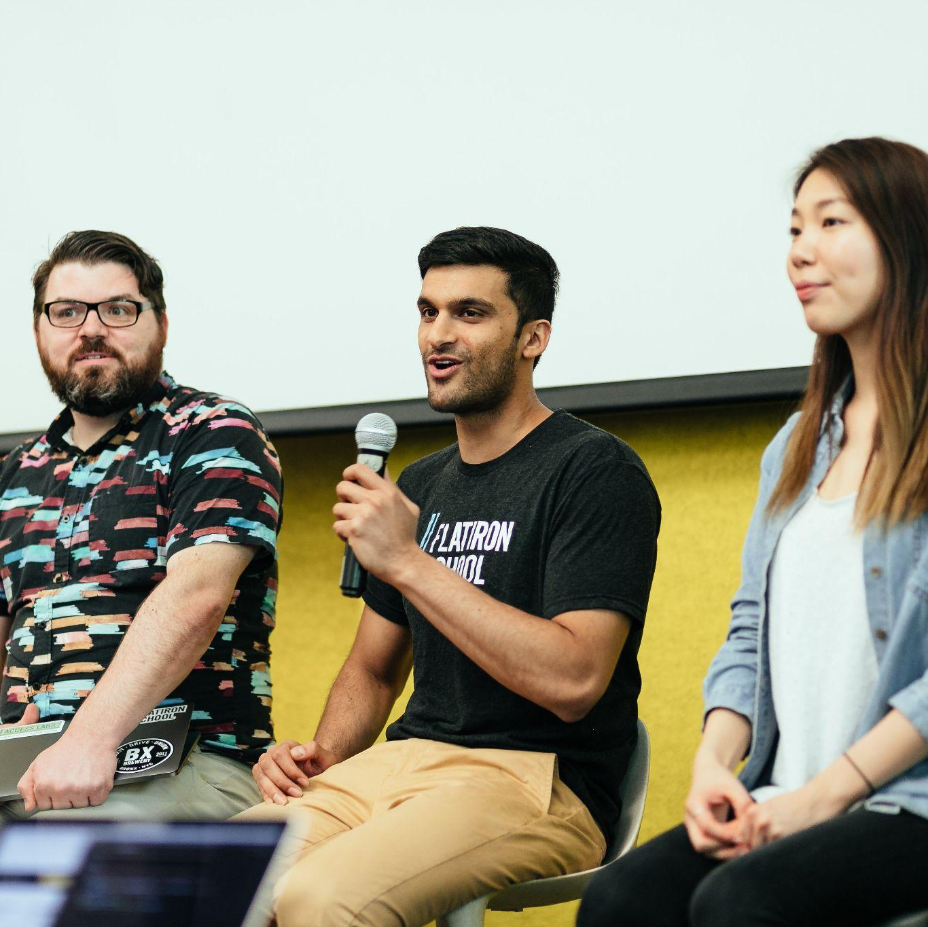
Blog Posts
Building a web presence demonstrating your data science chops is essential in the job search.
To help you do so, you will be required to write 4 blog posts: 1 for each phase (except Capstone).
Blog posts will be due on second Monday of the phase.
We will present our blogs to each other during stand downs after the blog post due dates.

Slide 30
That’s right - first blog post is due next week!
First blog post topic: Why did you decide to learn data science?
Potential elements to include:
Your past educational or career experience
How you learned about data science
Any particular data science-related projects that you find especially exciting
How you chose Flatiron School
What you're hoping to do with data science in the future

Slide 31
Weeks 1 & 2
Checkpoints

Slide 32

Checkpoints
Mini-assessments to check your understanding and key proficiencies.
You will have 1 hour to complete the checkpoint.
Checkpoints give you a chance to practice coding in a time-boxed session without the pressure - these assessments are not used to judge whether you progress through the program!

Slide 33
Weeks 1 & 2
Code Challenges

Slide 34

Code Challenges
End-of-phase challenges that simulate real-world workflows or technical interviews.
This will feel just like the checkpoints, but you will have 1 hour 30 minutes to complete the code challenge.
This is one place where no collaboration is allowed. We encourage you to ask instructors questions, but these are your own work.
Notes:
Can mention at the end about the graded assignment protocol, since that’s the next slide

Slide 35
Graded Assignment Protocol
Assessments are open book (ok to reference labs, lectures, notes)
No copy and pasting code (that means no copying from Stack Overflow or Chat-GPT)
No screen sharing or messaging with peers during graded assignments
Notes:
This applies to both check points and code challenges! But especially code challenges.

Slide 36

Evaluating Student Progress
In order to advance through the program, we need to know that you have mastered the essentials.
If you do not pass the code challenge, you will have the opportunity to demonstrate your readiness to move on through the completion of a graded, solo project.
The final pass/not pass assessment happens at the end of each phase.
Notes:
AKA what happens if I don’t pass the code challenge? A nice segue into discussing the projects

Slide 37
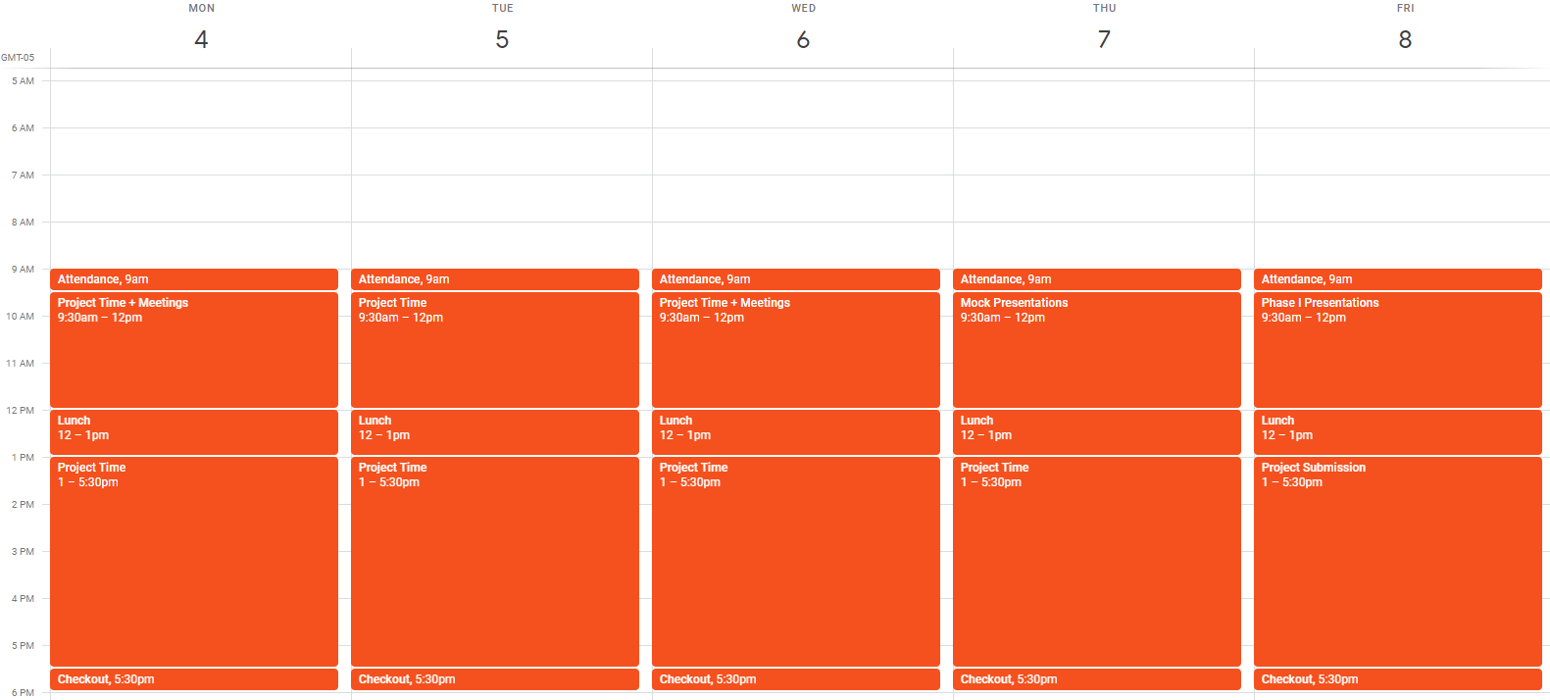
Week 3
Project
Week

Slide 38

Projects
Either solo or in groups, you will tackle real problems to develop projects you can showcase to potential employers.
Your project will consist of both technical and non-technical deliverables.
Project presentations are a chance to gain experience presenting your findings to a non-technical audience.
The requirements for each project will be outlined in the rubric, which we will go over during the project launch.

Slide 39

Setting Yourself Up for Success

Slide 40
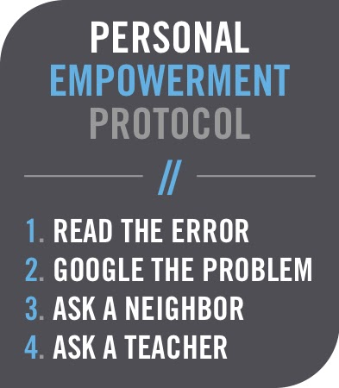
Personal Empowerment Protocol
This is an important framework in general for debugging / working through problems.
Reading errors, looking up problems, and collaborating with peers are essential skills.
Get practice with them before asking us!

Slide 41
Giving Feedback: C - A - S - K
Consensual
Actionable
If someone isn't in a good space to receive feedback, it won’t stick and it won’t help.
Outline ways to change or act on the feedback, instead of saying something vague like “this is bad”.
Specific
Kind
Give examples when you can, to anchor your feedback in a real way to the experience you had which prompted the feedback.
The goal is to help someone improve, not to belittle others.

Slide 42

Any Questions?

